Slide 1
THE CURRENT SITUATION

Slide 2
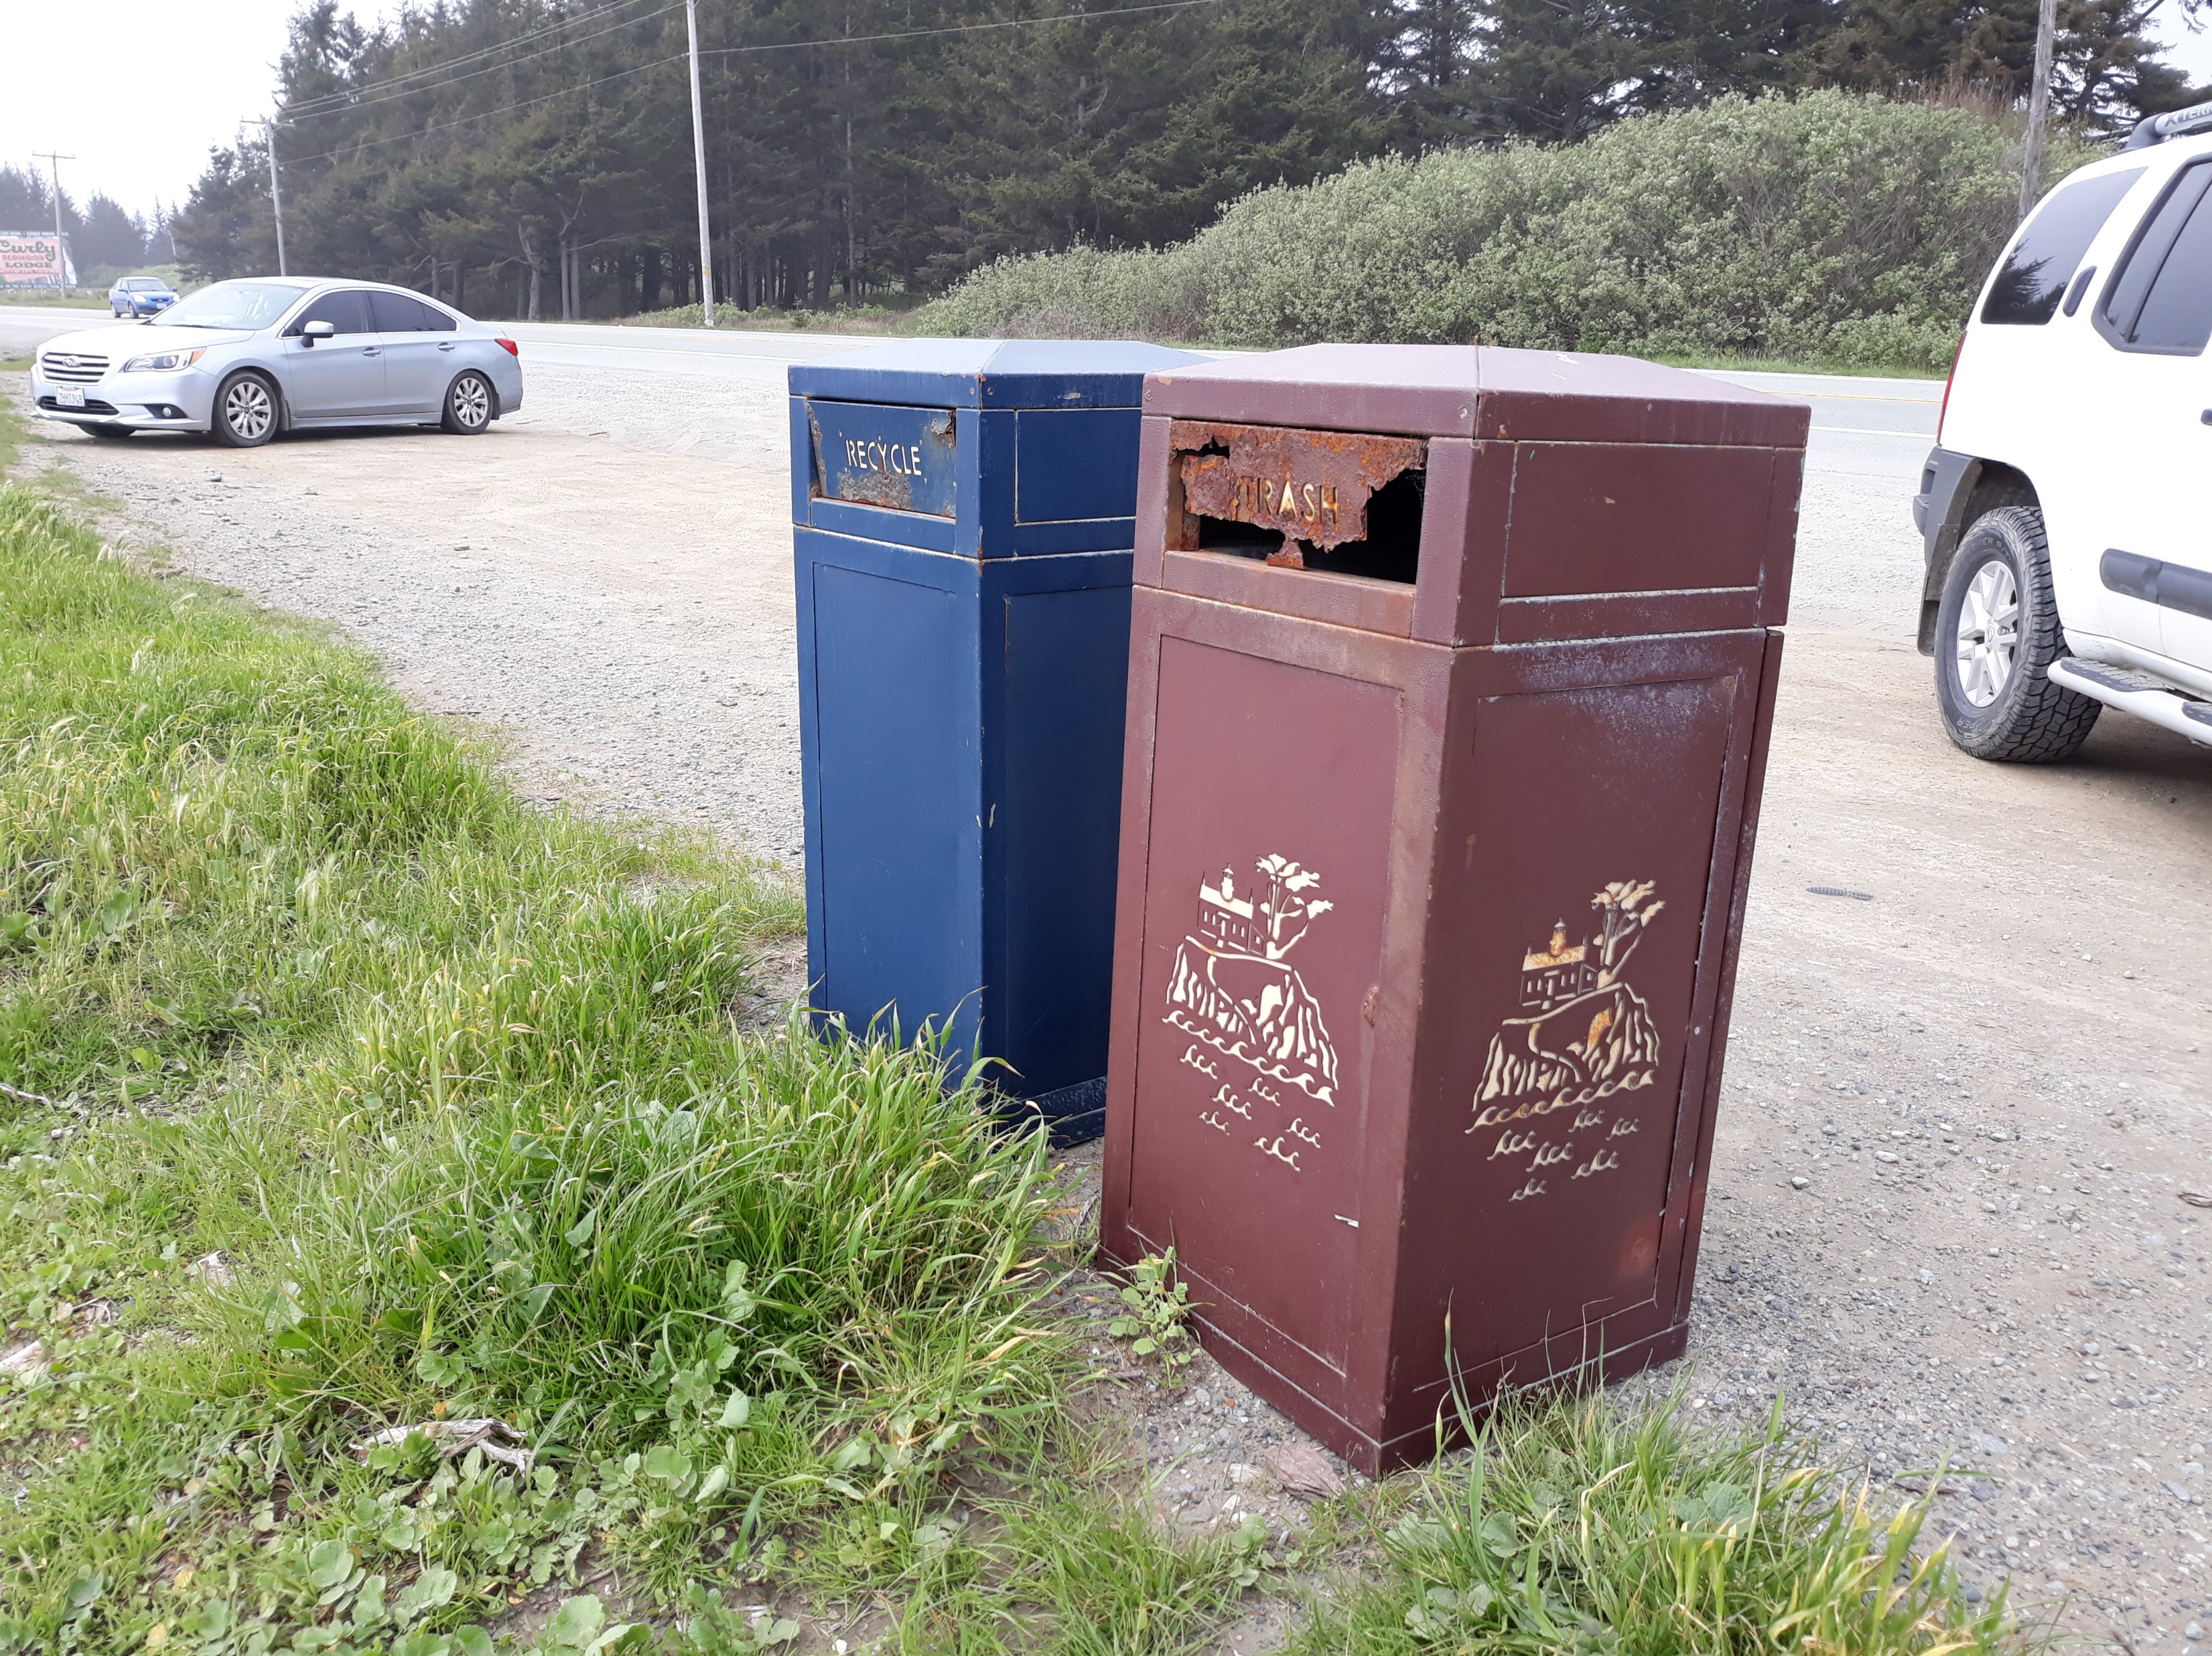

Slide 3
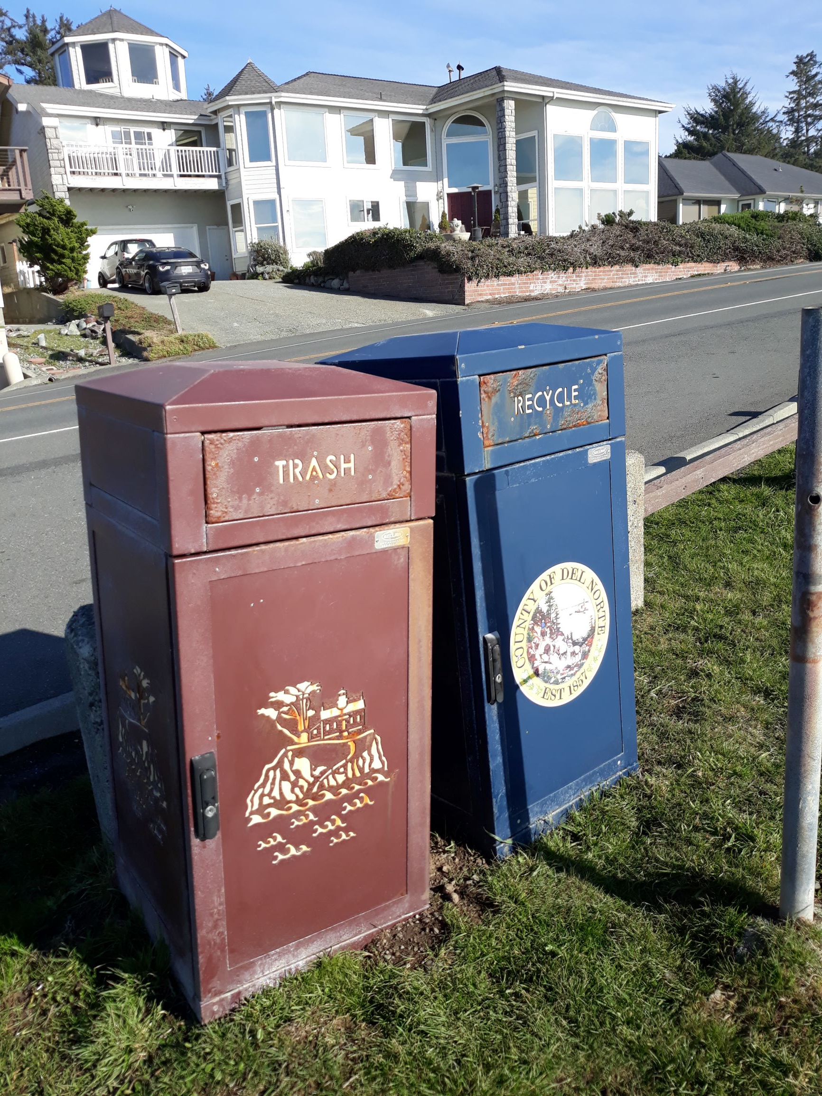
Design challenges
Due to lightweight construction, bins were tipping over, which chipped off the powder coating, and made them quite susceptible to rust.
The filigree laser cut design is also problematic due to rust
The wind and salt air caused an increased need for costly maintenance, requiring replacement of panels, and some entire receptacles.

Slide 4
New option, Outdoor Creation’s concrete receptacles.

Slide 6
Concrete receptacles
The use of concrete addresses many of the issues caused by our coastal environment.
The weight provides stability.
The material resists oxidization.
Other issues like vandalism would be less structurally damaging.

